Slide 1

Participation and collective action
Hasan Muhammad Baniamin

Slide 2
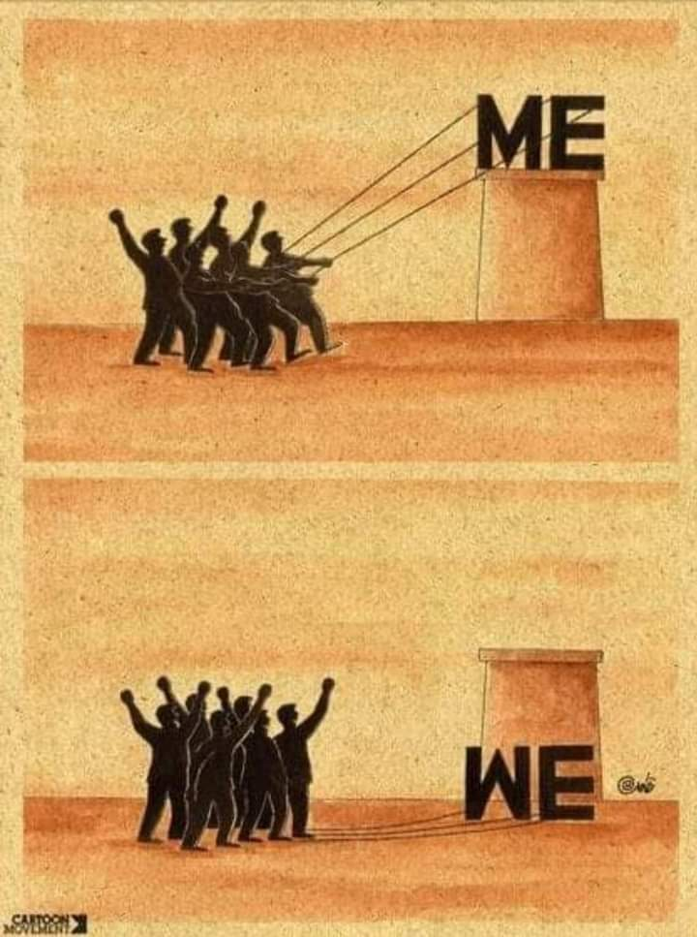

Slide 3
An anthropologist showed a game to the children of an African tribe ...
He placed a basket of delicious fruits near a tree trunk and told them: The first child to reach the tree will get the basket.
When he gave them the start signal, he was surprised that they were walking together, holding hands until they reached the tree and shared the fruit!
When he asked them why you did that when every one of you could get the basket only for him!
They answered with astonishment: Ubuntu.
"That is, how can one of us be happy while the rest are miserable?"
Ubuntu in their civilization means: (I am because we are).

Slide 4
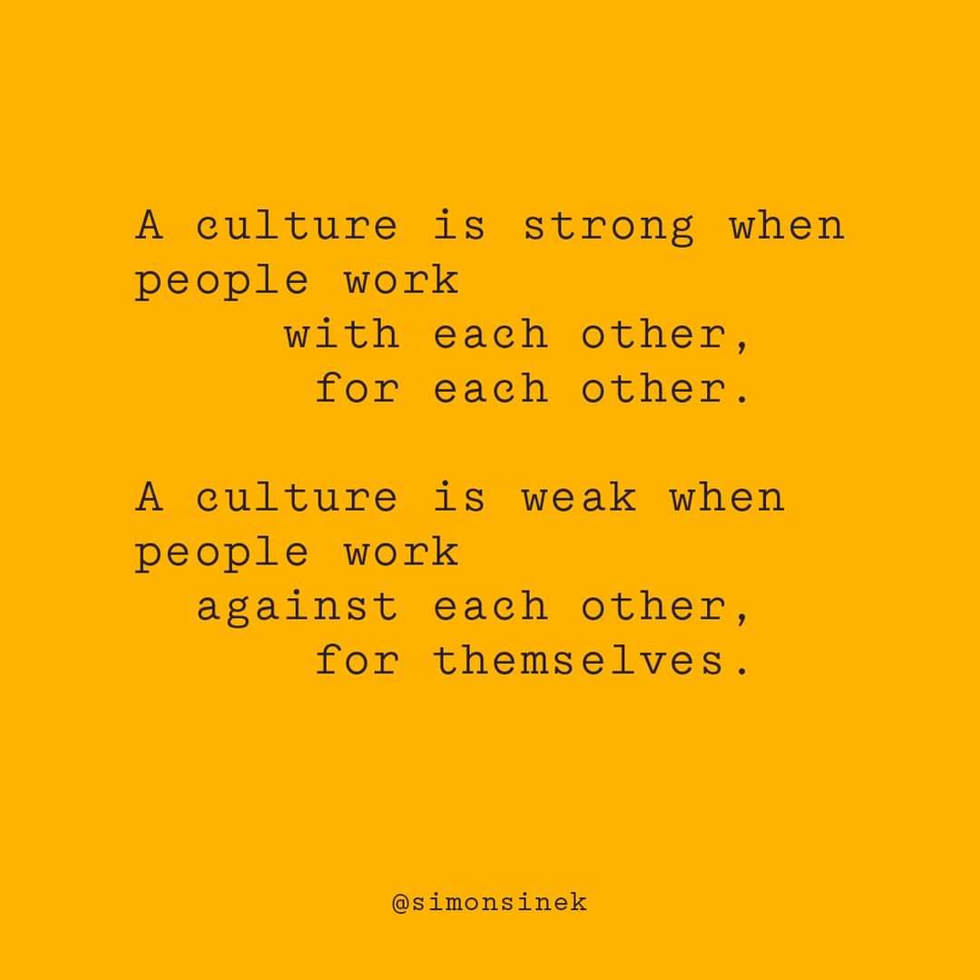

Slide 5
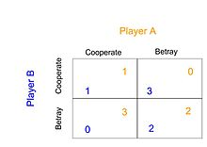
The Prisoners’ Dilemma

Slide 6
The Prisoners’ Dilemma
Two criminals have been arrested on suspicion of a crime and are thrown into prison in two separate cells. Both prisoners can choose either to cooperate (deny everything) or defect (confess to the crime and implicate the other man). The prison officers cannot arrest either of them without the confession of one or both men so attempt to cut a deal:
  If only one prisoner confesses, the confessor will be set free for collaborating and given a full pardon (0 year). The one who kept quiet will be thrown into jail with the harshest possible sentence (3 years) as punishment for both the crime and for withholding evidence.
  If both prisoners are silent, they will both be sent to jail but due to lack of evidence both will get 1 year imprisonment.
  If both prisoners defect, then both will get 2 years of sentences.
  Both prisoners know full well that without a confession from either of them, the police will not be able to impose highest punishment.

Slide 7
Key Definitions
RATIONAL (in the Economic Sense) = to Maximize One's Expected Return (Total Expected Benefits Less Total Expected Costs).
Social Dilemma
  refers to a setting in which individuals choose actions in an interdependent situation. If each individual selects strategies based on a calculus that maximizes short‐term material benefits to self, individuals will take actions that generate lower joint outcomes than could have been achieved. (Ostrom, 2009)
  Parties/Individuals have asymmetric interests, selfish short term interest vs. long term collective interest, non-credible commitments

Slide 8
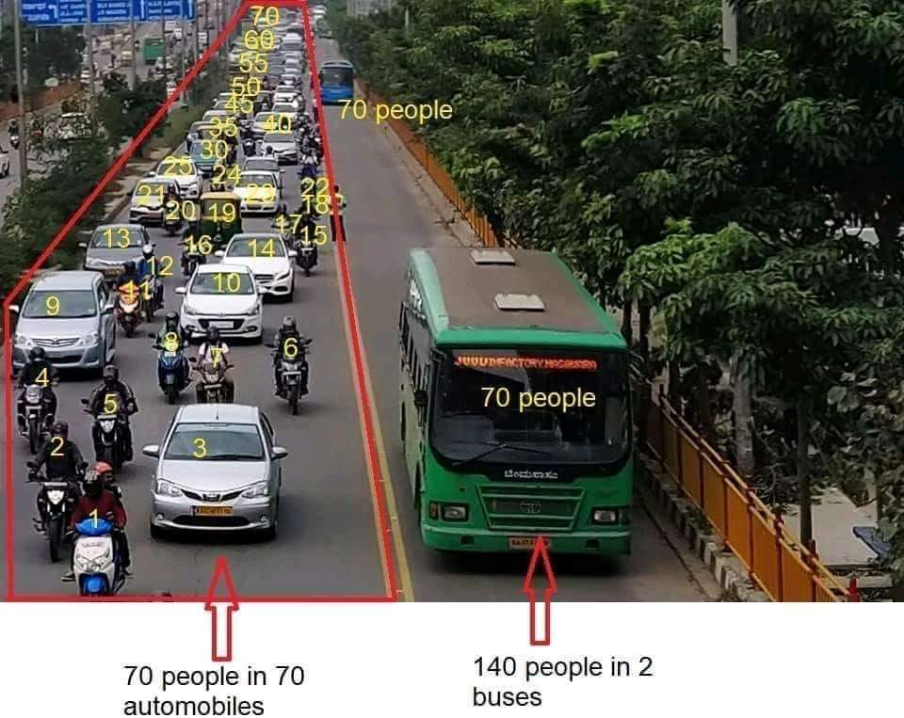

Slide 9
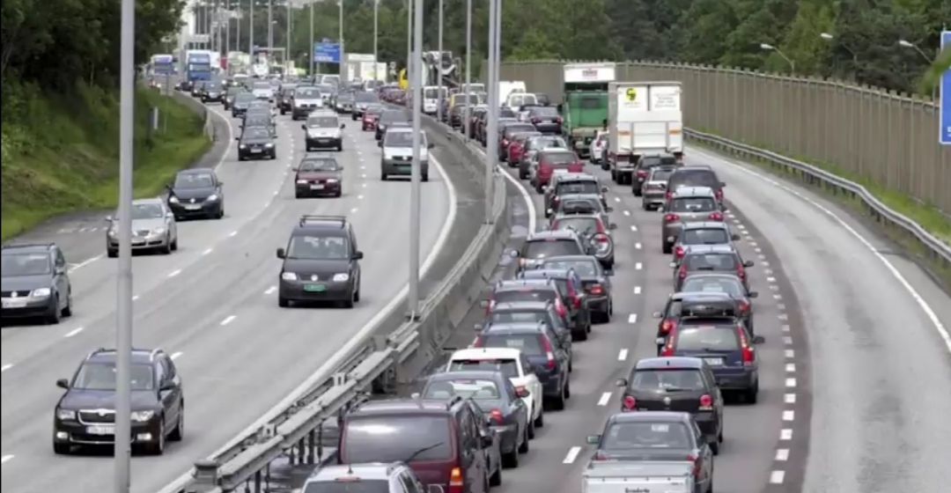
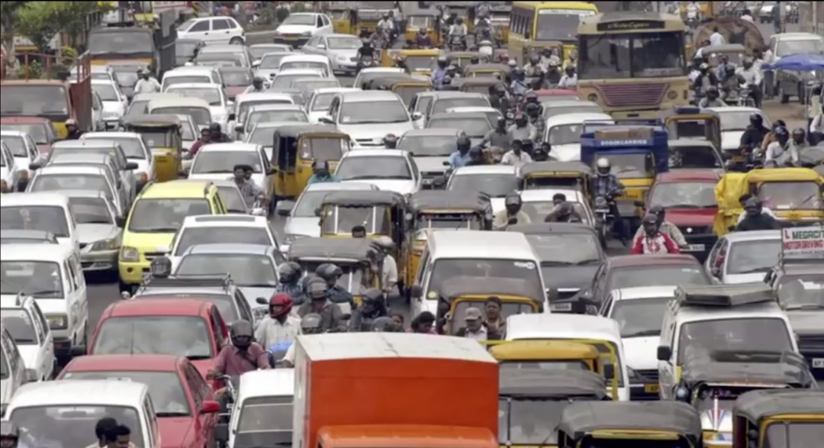

Slide 10
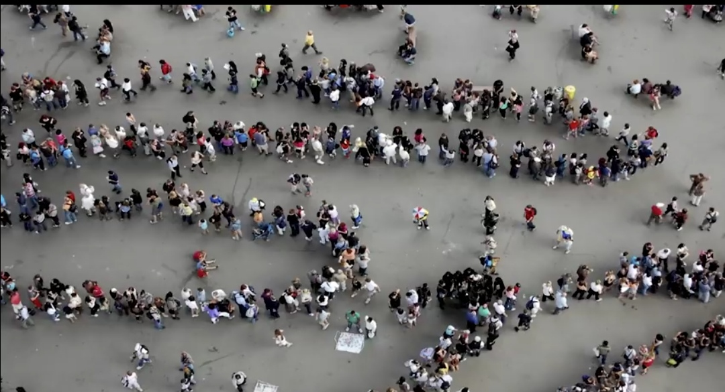
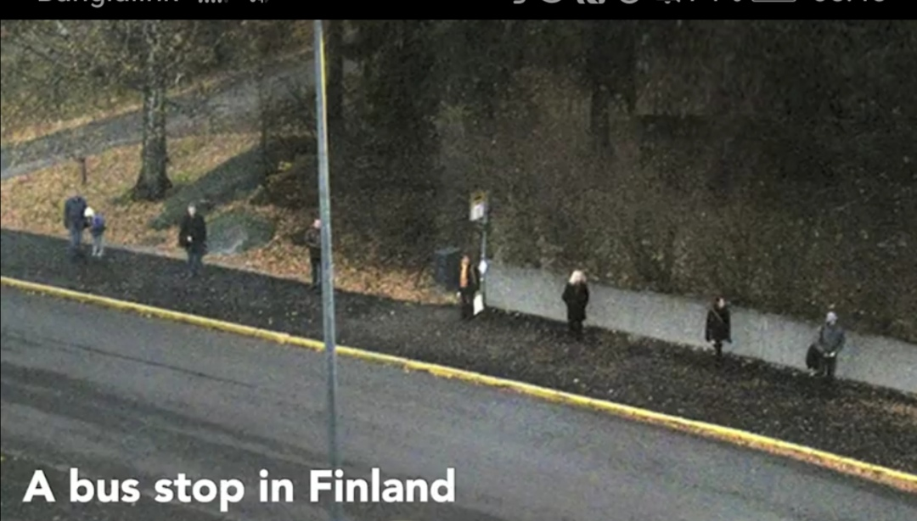
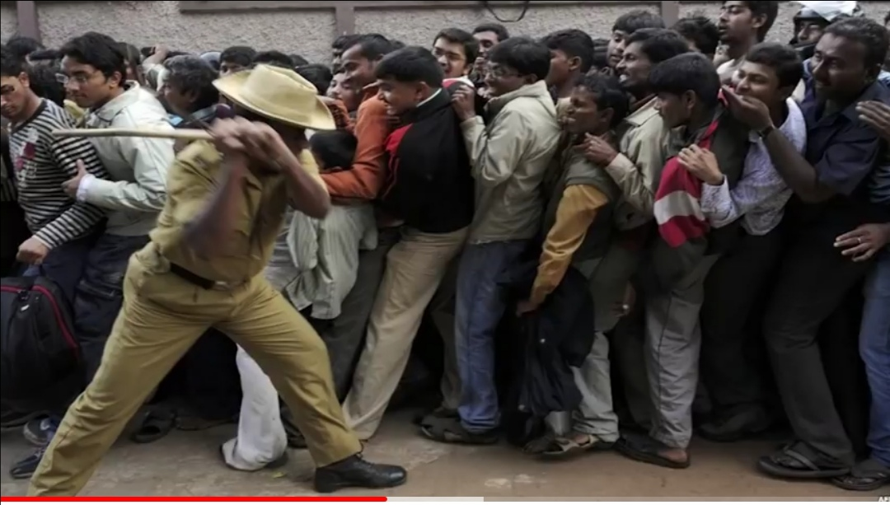

Slide 11
Key Definitions
COLLECTIVE ACTION PROBLEM = A situation in which everyone (in a given group) has a choice between two alternatives and where, if everyone involved acts RATIONALLY (in the economic sense), the outcome will be worse for everyone involved, in their own estimation, than it would be if they were all to choose the other alternative (i.e., than it would be if they were all to "irrationally" (in the economic sense)).
Collective Actions
    It indicates about how actors in the society (individuals, government, firms) cooperate to achieve mutually beneficial outcomes or collective objective

Slide 12
Key Definitions
Two Defining Characteristics of Goods or Services
  Subtractability/Rivalry: Does A’s consumption of a unit of that resource lower B’s potential enjoyment? Ex: food vs. air
  Exclusion: How costly is it for A to exclude B from access to that resource? Ex: fish stock vs. food.
Four Types of Goods or Services and the dilemmas most commonly experienced in their production or consumption:
  Private Goods: Subtractability and low costs of exclusion. Ex: food
  Public Goods: Nonsubtractability and high costs of exclusion. Ex: air
  Toll/Club Goods: Nonsubtractability and low costs of exclusion. Ex: cinema
  Common Pool Resources (CPRs): Subtractability and high costs of exclusion. Ex: fish stock

Slide 13
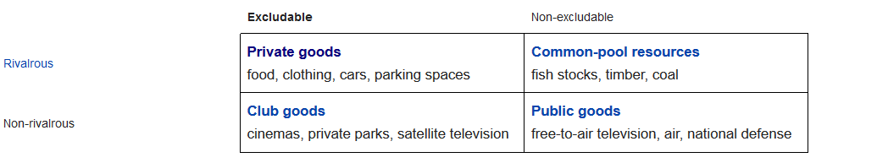
Types of Goods or Services

Slide 14
The Free Rider
Arises from the exclusion problem.
A free-rider is a person who receives the benefit of a good but avoids paying for it. Each person hopes other will pay for it.
Notes:
People who accept benefits without paying their fair share of the cost of providing those benefits.

Slide 15
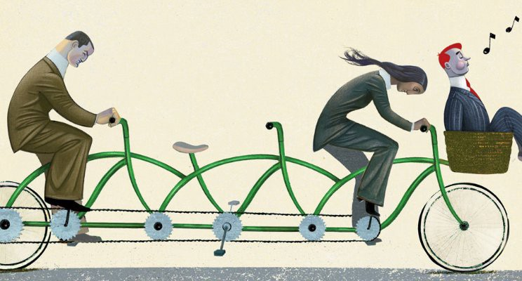
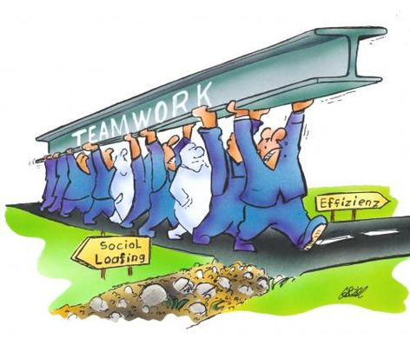

Slide 16
Tragedy of the Commons
The free rider problem with common resources
Common resources tend to be used excessively when individuals are not charged for their usage.
Notes:
illustrates why common resources get used more than is desirable from the standpoint of society as a whole.
Like a negative externality.

Slide 17
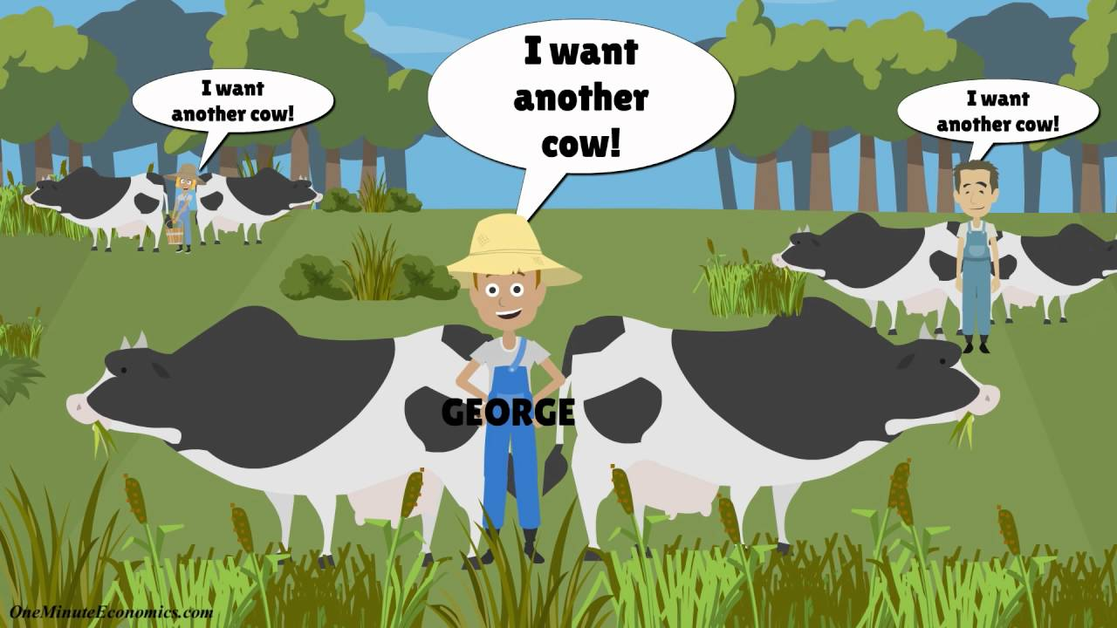

Slide 18
Tragedy of the Commons
  The parable (Hardin 1968):
  A herdsman puts his animals on the pasture he uses in common with other herdsmen. Even though signs exist of pasture degradation with overstocking, it is “rational” for each herdsman to add more animals because he gains full benefits of each extra animal while sharing costs of overgrazing with other herdsmen. ….. “Freedom in the commons brings ruin to all.”
Notes:
illustrates why common resources get used more than is desirable from the standpoint of society as a whole.
Like a negative externality.

Slide 19
Free Rider Problem and Common Pool Resources
Will anyone have adequate incentive or situation to restrain themselves in the appropriation and provision of common pool resources?
Notes:
We want to see poor people helped but want to see others do helping. So we behave like free riders. Hold back a bit hoping that others contribute enough to take care of problem.

Slide 20
Cooperation
Cooperation is defined as a group of individuals acting together to a common end.
Club goods- mutual benefits to participants from sharing costs and consumption (sharing cost for playing badminton/tennis).
Public goods- when coerced into it (Restriction on fishing Hilsha fish).
Common goods- trust, common understanding, feasible improvement.

Slide 21
The Evolution of Cooperation
Theories in the evolution of cooperation:
  Kin Selection
  Group Selection/Reciprocity

Slide 22
Kin Selection
Why should we cooperate?
  We should cooperate and behave altruistically for the good of our offspring.
When do we cooperate?
  According to kin selection, we only cooperate when interacting with those who have a high degree of relatedness to us-honeybee.

Slide 23
Group/ Reciprocity Selection
Why should we cooperate?
  Because the benefits to creating competitive advantage at the group level may outweigh the individual benefits to being ‘selfish’.
When do we cooperate?
  We cooperate with others when they demonstrate that they are cooperators, or altruistic

Slide 24
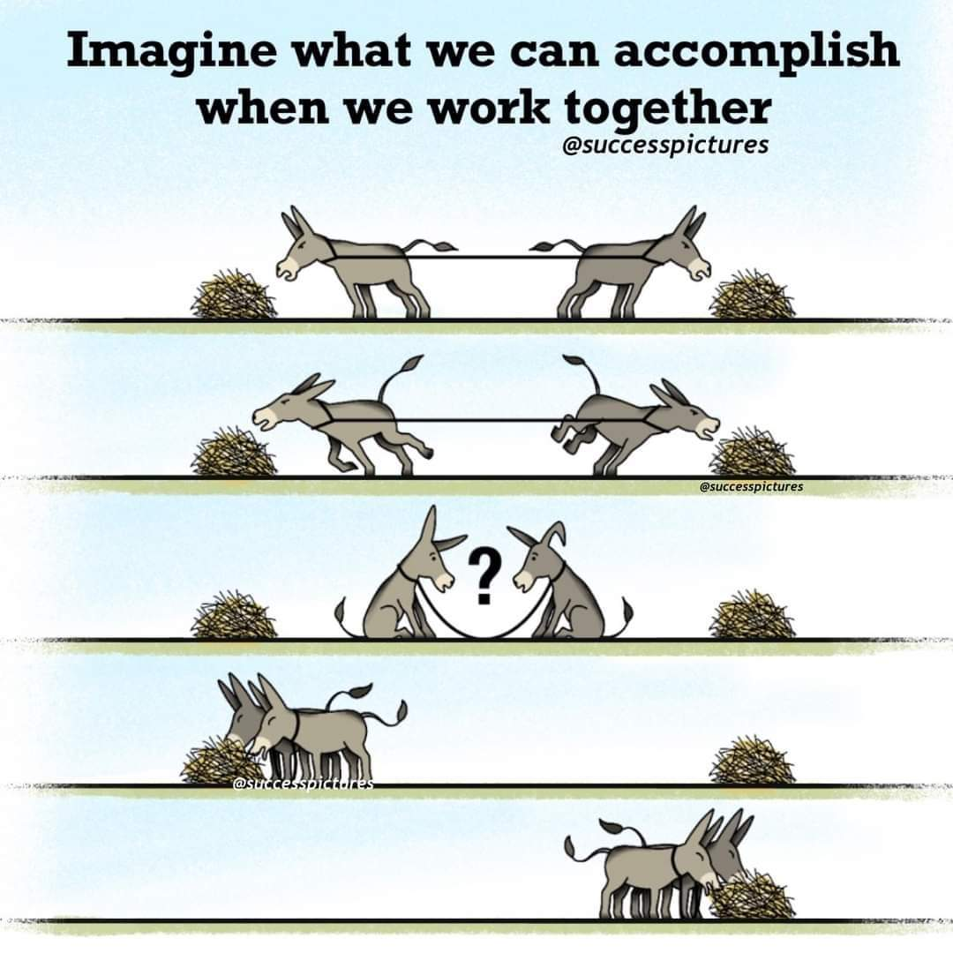

Slide 25
Suggested readings
Gillinson, S. (2004). Why Cooperate?: A Multi-disciplinary Study of Collective Action. London: Overseas Development Institute. Link: https://www.odi.org/sites/odi.org.uk/files/odi-assets/publications-opinion-files/2472.pdf

Slide 26
Q?

